Slide 1
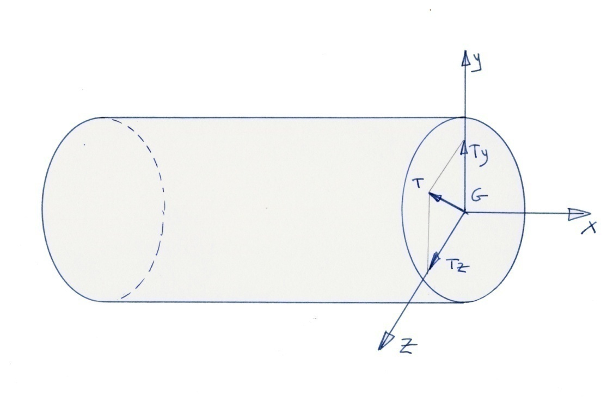
Shear Force
Shear Force - Tian Jin - 2011

Slide 2
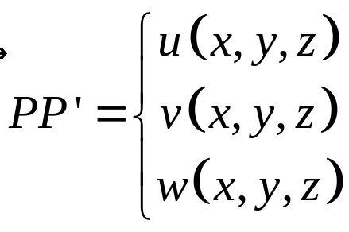
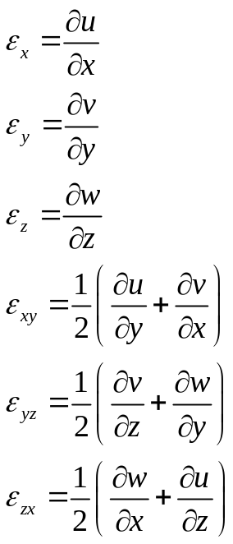
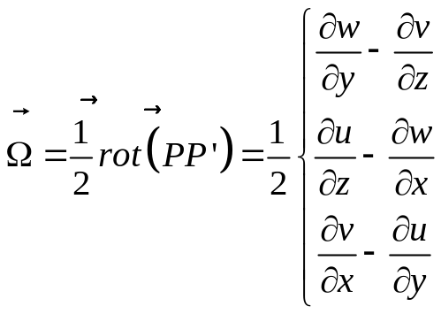
Remumber what we need !
Shear Force - Tian Jin - 2011

Slide 3
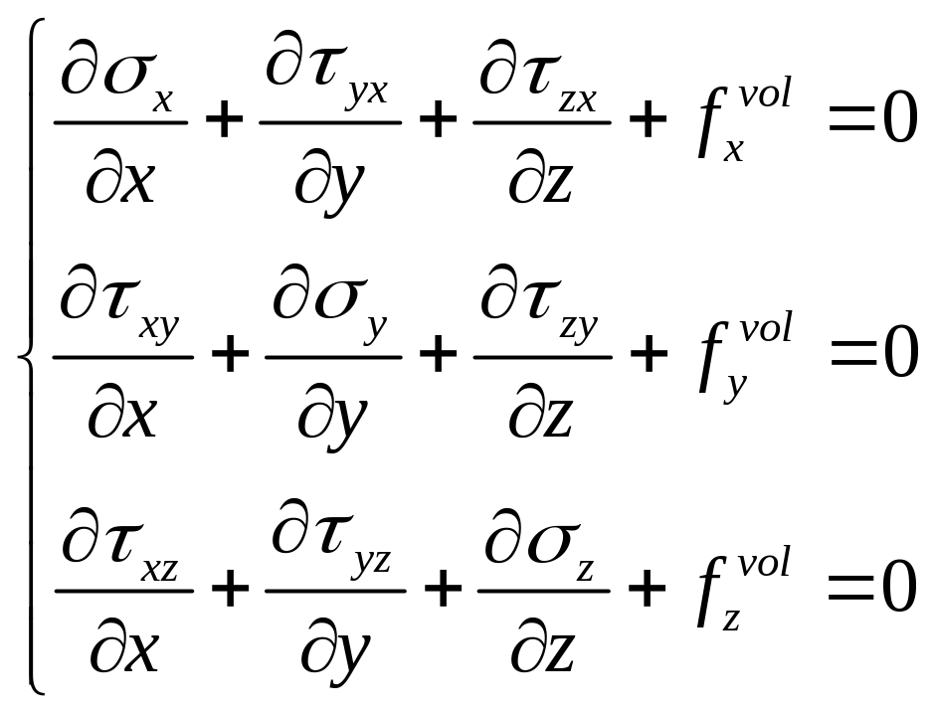
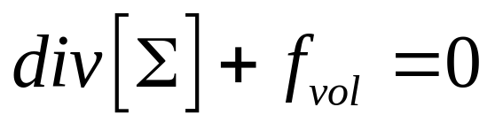
Equilibrium Equations
Shear Force - Tian Jin - 2011

Slide 4
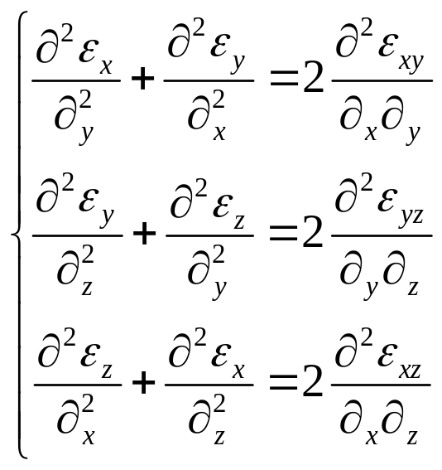
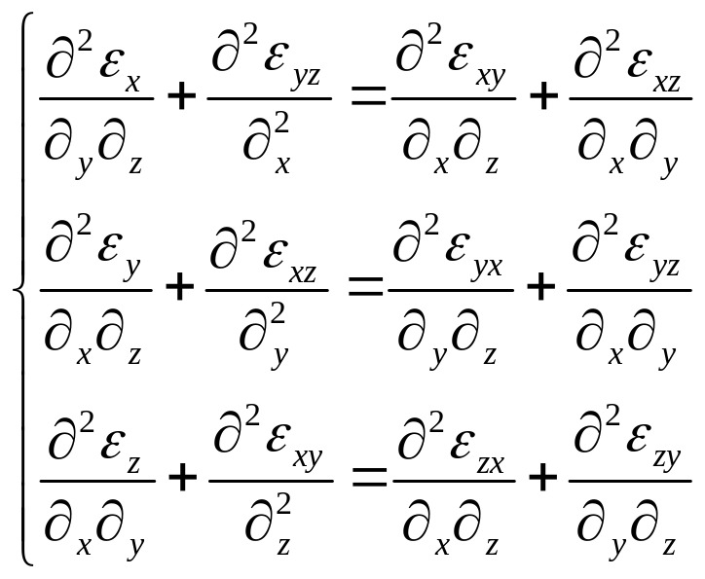
Equation for Compatibility
Shear Force - Tian Jin - 2011

Slide 5
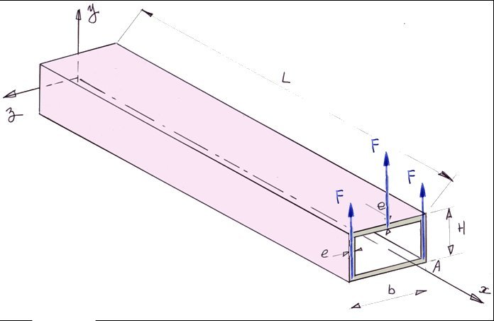
Shear Stresses
The elasticity explains us that the shear force
or (and) the twisting moment creates shear stresses
Shear Force - Tian Jin - 2011

Slide 6
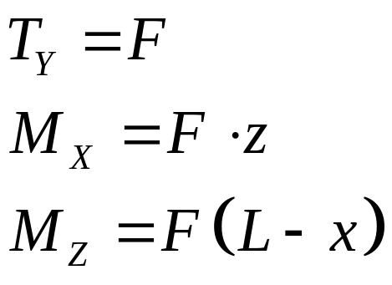
Internal load
The load applied on the side x=L, creates the same shear
force Ty and the same bending moment Mz on the current
cross section whatever the position of the load applied.
The twisting moment depends of the position of the load applied
Shear Force - Tian Jin - 2011

Slide 7
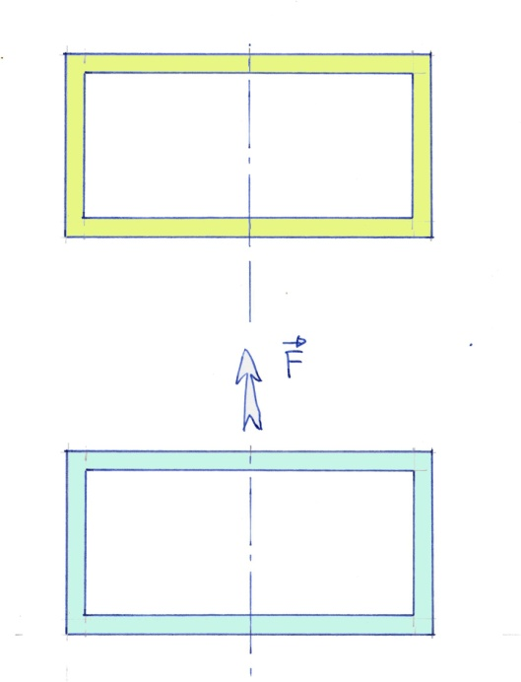
Behaviour in the Case Z = 0
The moment Mx is equal to zero
Final position
Initial position
Shear Force - Tian Jin - 2011

Slide 8
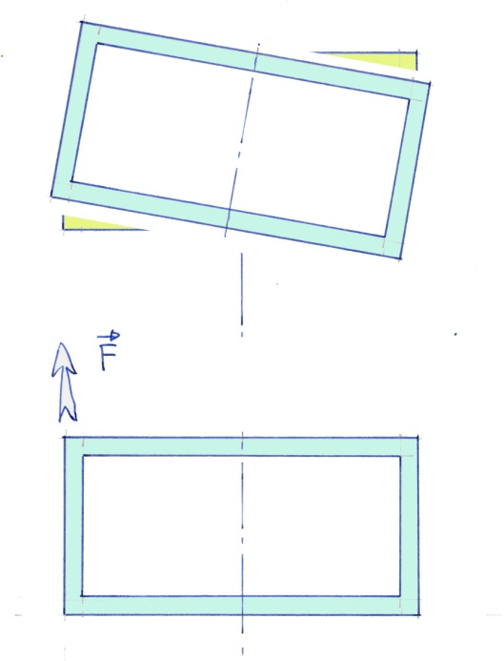
Behaviour in the Case Z > 0
Final Position, result of
a vertical translation and a rotation
Shear Force - Tian Jin - 2011

Slide 9
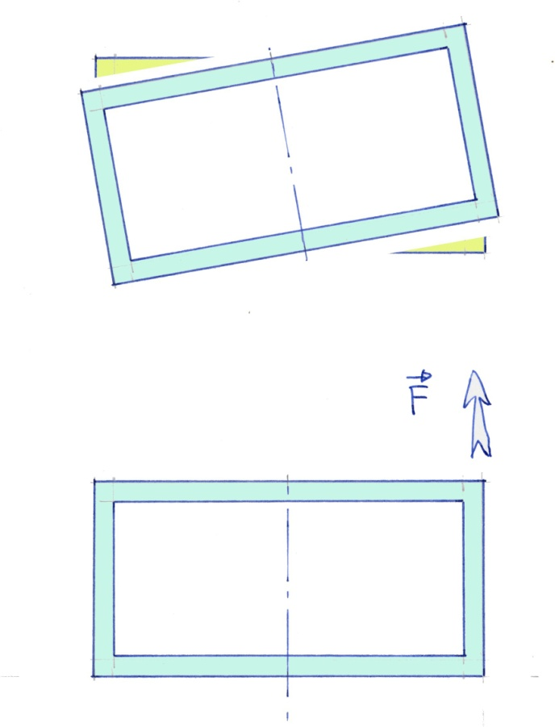
Behaviour in the Case Z < 0
Final Position, result of
a vertical translation and a rotation
Shear Force - Tian Jin - 2011

Slide 10
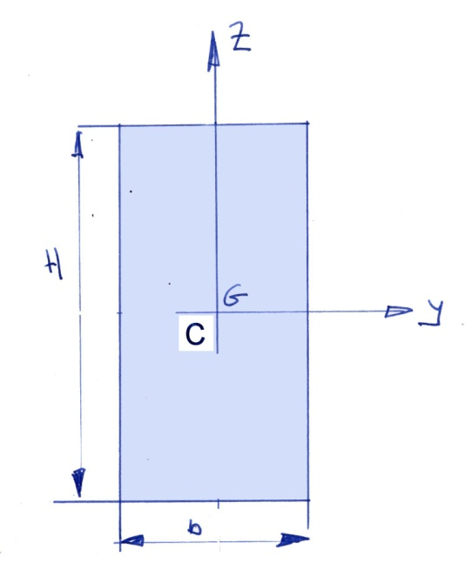
Shearing Center
The shear force will be applied in a point C such
as the displacement of the cross section will be a
translation in the direction of the shear force.
Rule for the shearing center : If the cross section has an
axis of symmetry, then the shearing center will be on this axis
Shear Force - Tian Jin - 2011

Slide 11
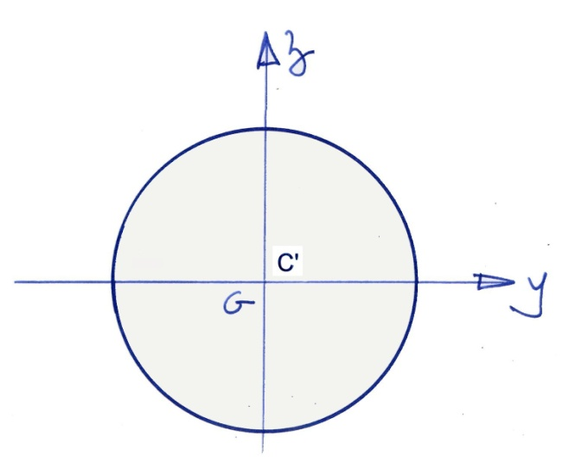
Twisting Center
The twisting moment will be applied in a point C’ such as the displacement of the cross section will be a rotation around the axis C’X
Shear Force - Tian Jin - 2011

Slide 12
Elastic solution
This solution is due to M. Barré de Saint Venant
Adhémar, Jean-Claude Barré de Saint-Venant, born in 1797 at Villiers-en-Bière (Seine-et-Marne) and died in 1886 at Saint-Ouen (Loir-et-Cher), is a famous French engineer, physicist and mathematician.
Shear Force - Tian Jin - 2011

Slide 13
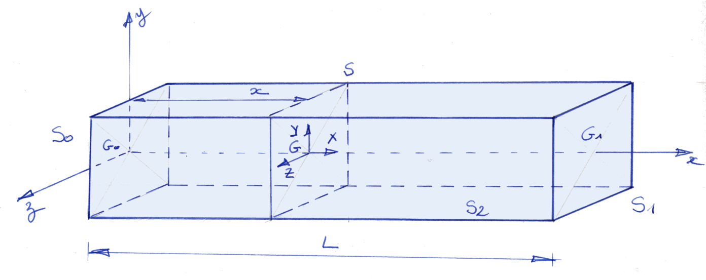
Elastic solution
Constant Cross section / Initial section S0 / Final section S1
xyz general axis system / XYZ principal axis system
Lateral Surface : S2
Current Cross Section defined by the value x
Shear Force - Tian Jin - 2011

Slide 14

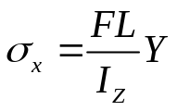
Elastic solution : Load on the beam
Final Cross section S1 :
- a field of shear stresses such as the resultant is F and the moment is zero
Initial cross section S0 :
a field of shear stresses such as the resultant is -F and the moment is zero
a field of normal stresses such as
Lateral Surface S2 :
- free surface => No Load
Shear Force - Tian Jin - 2011

Slide 15
Equilibrium of the whole beam
Sum of the forces
Sum of the moments in G0 for instance
Shear Force - Tian Jin - 2011

Slide 16
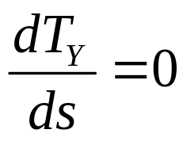
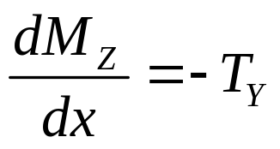


Equations of Equilibrium
- Straight line for the middle curve,
Load in the plane XY
When a shear force exists, a bending moment appears !
The shear Force creates a shear stress
The bending moment create a normal stress
Shear Force - Tian Jin - 2011

Slide 17
Elastic solution
The solution must verify :
- The equilibium equations
- The boundary conditions,
- The compatibility equations,
- The Hook’s Law, relationship between stress and strains
Shear Force - Tian Jin - 2011

Slide 18
Equilibrium’s Equation
Shear Force - Tian Jin - 2011

Slide 19
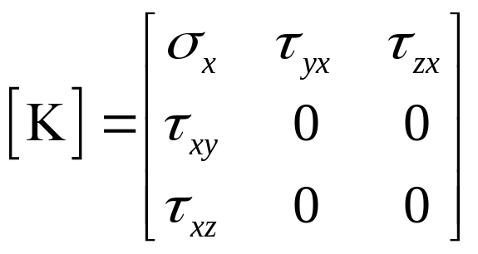
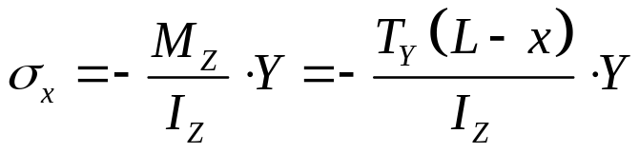
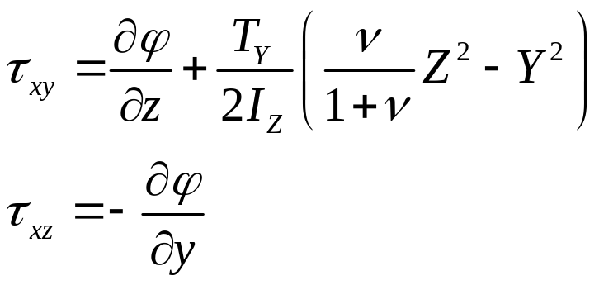
Elastic solution
Assumption on the stresses
Shear Force - Tian Jin - 2011

Slide 20
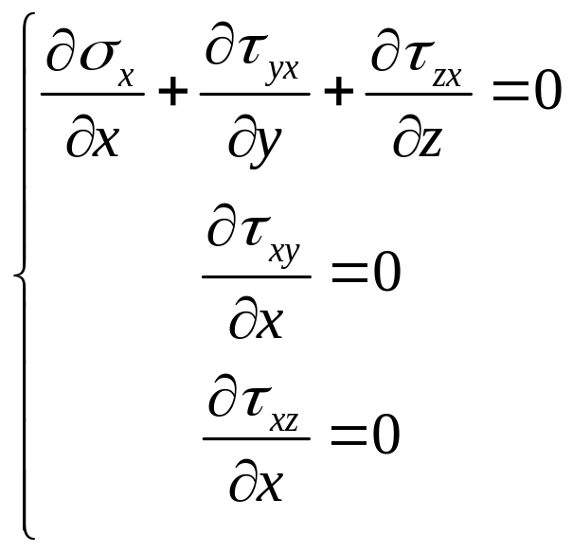
Equilibrium’s Equation
The first equation is verified
The second and third equations
are such that the shear stresses don’t depend of x
Shear Force - Tian Jin - 2011

Slide 21
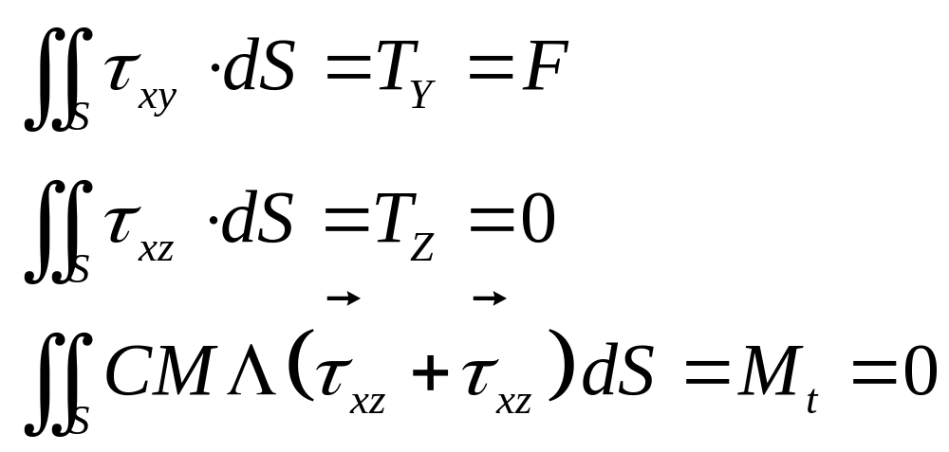
Elastic solution :
BC’s on S0 ans S1
Shear Force - Tian Jin - 2011

Slide 22
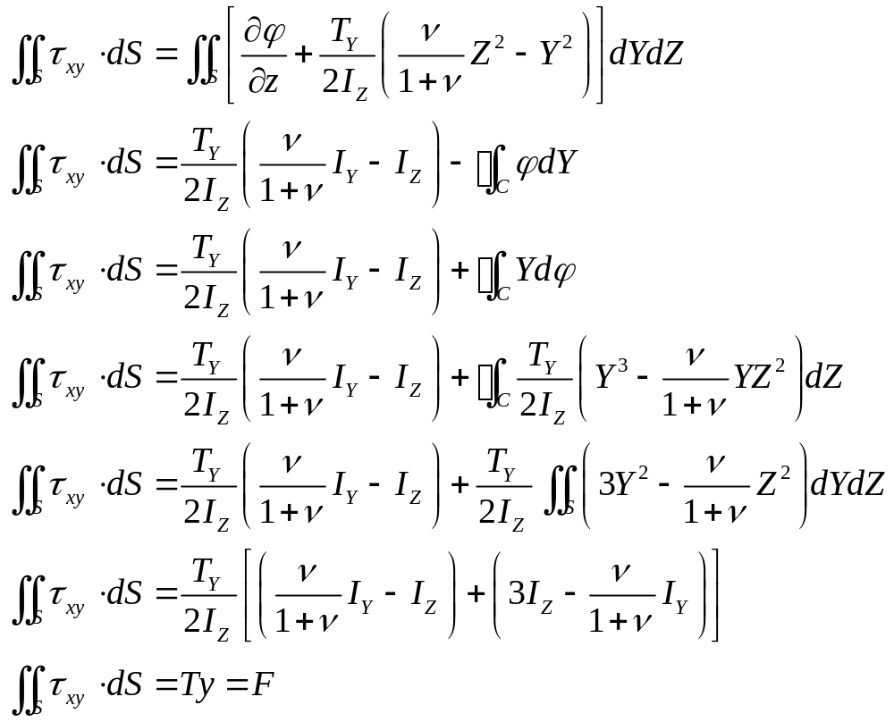
BC’s on S1
Shear Force - Tian Jin - 2011

Slide 23
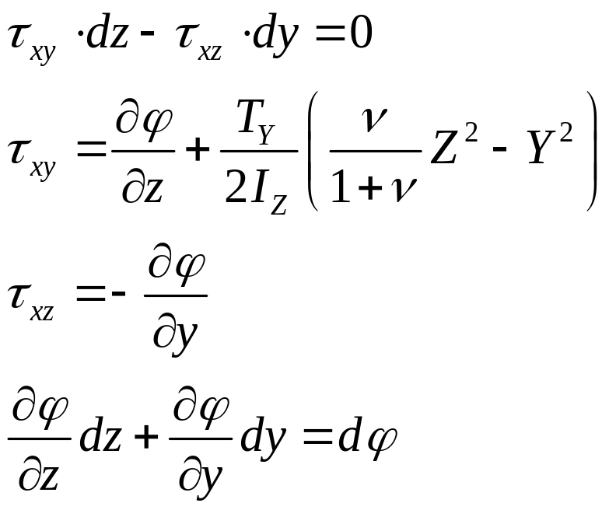
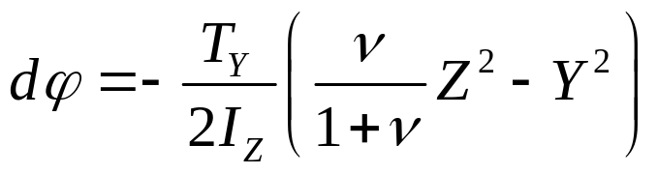
Elastic solution :
Boundary Conditions on Lateral Free Surface
Shear Force - Tian Jin - 2011

Slide 24
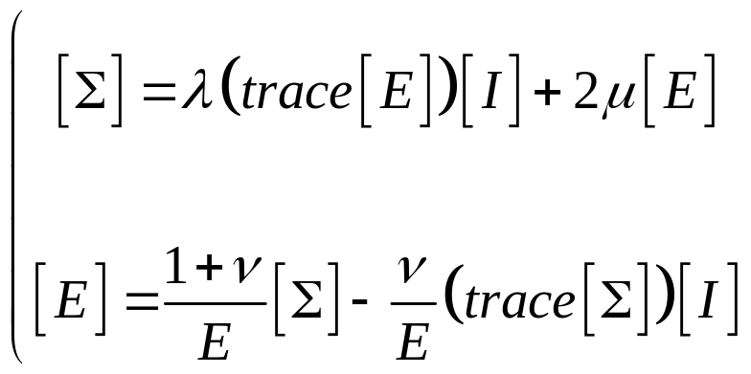
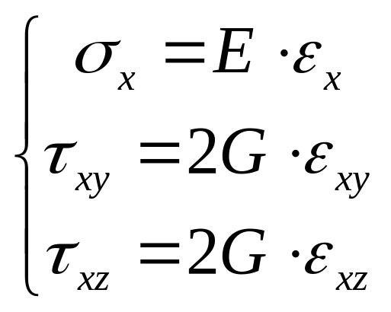
Relationship Stress/ Strain
Shear Force - Tian Jin - 2011

Slide 25
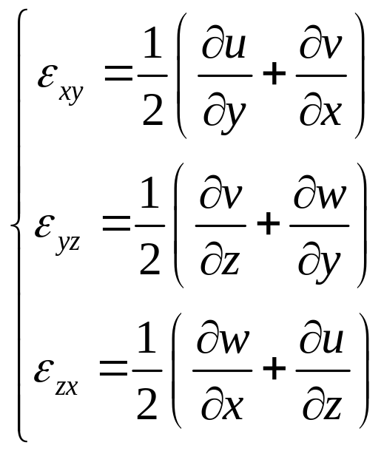
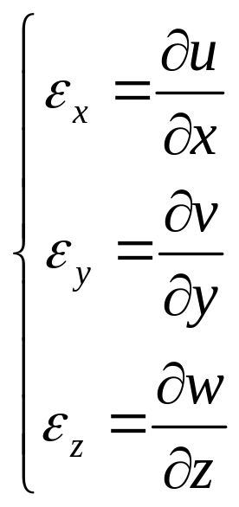
Elastic solution
Displacements
Shear Force - Tian Jin - 2011

Slide 26
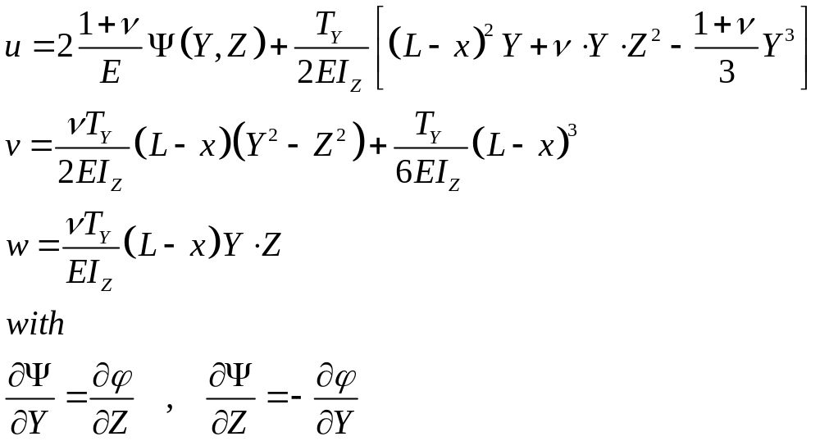
Elastic solution
Displacements
Shear Force - Tian Jin - 2011

Slide 27
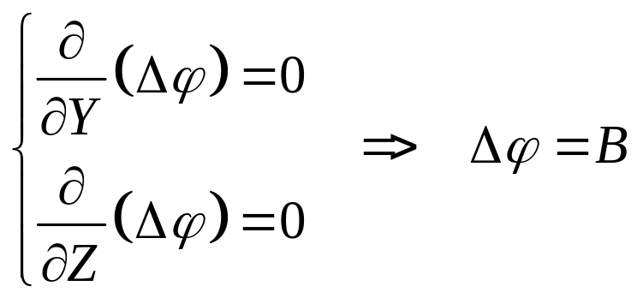
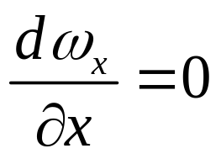
Elastic solution
Compatility Equations
It’s possible to show that B=0 by computing :
Shear Force - Tian Jin - 2011

Slide 28
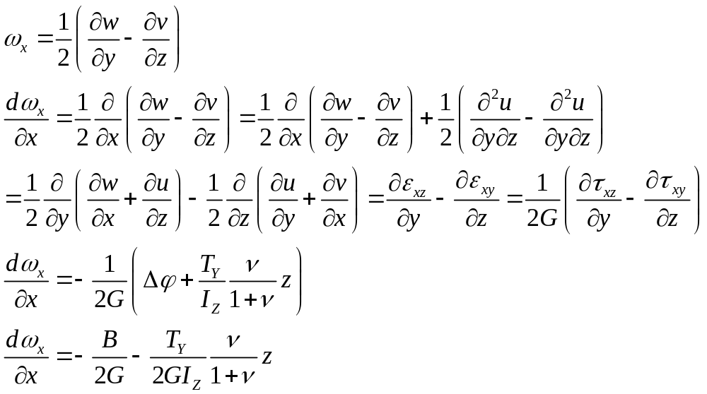
Elastic solution
Compatility Equations
Shear Force - Tian Jin - 2011

Slide 29
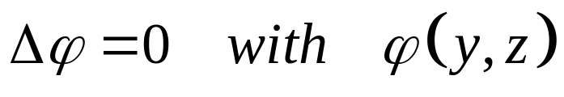
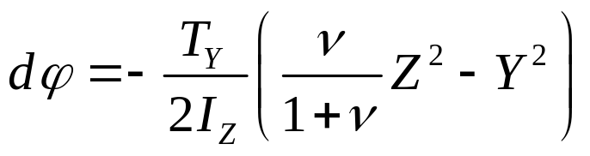

Elastic solution
Process
Find a function such as
With on the boundary of the cross section
Once is known,
the stresses are known, (slide 19)
the strains also, (slide 24)
ans the displacements. (slide 26)
Shear Force - Tian Jin - 2011

Slide 30
Elastic solution
Conclusions
The principal results are :
It is hard to find the field of stresses
The cross section does not stay in a plane. There is a phenomenon of warping
It could be interresting to find a simple solution with a good approximation on the results.
We need hypothesis to simplify the problem !
Shear Force - Tian Jin - 2011

Slide 31
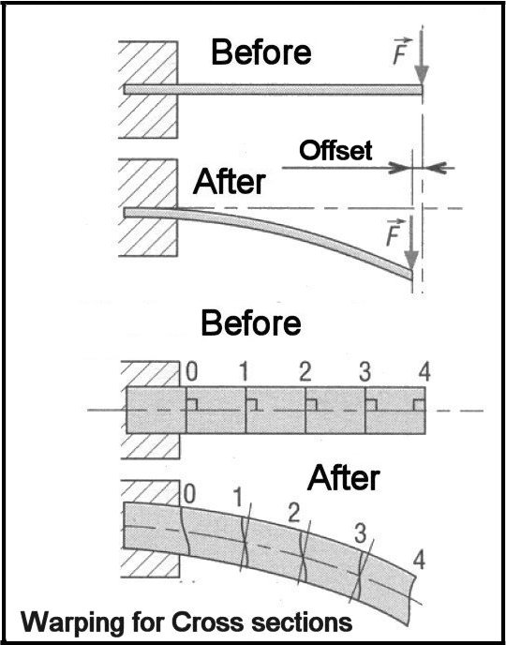
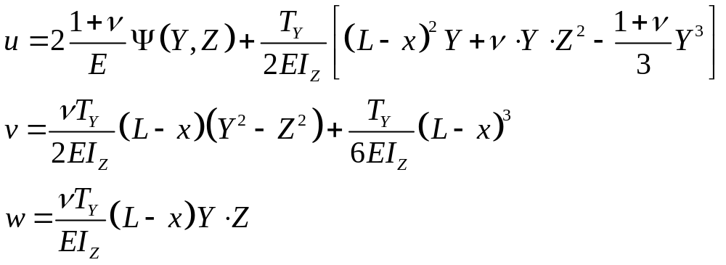
Reality
Shear Force - Tian Jin - 2011

Slide 32
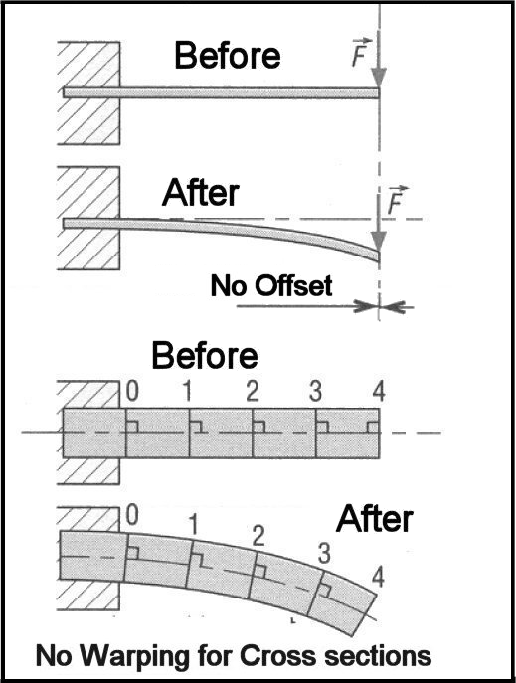
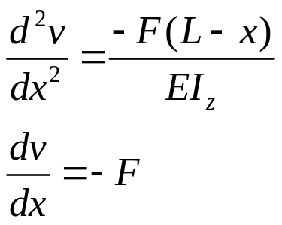
Hypothesis
Assumption on the field of displacement
Shear Force - Tian Jin - 2011

Slide 33
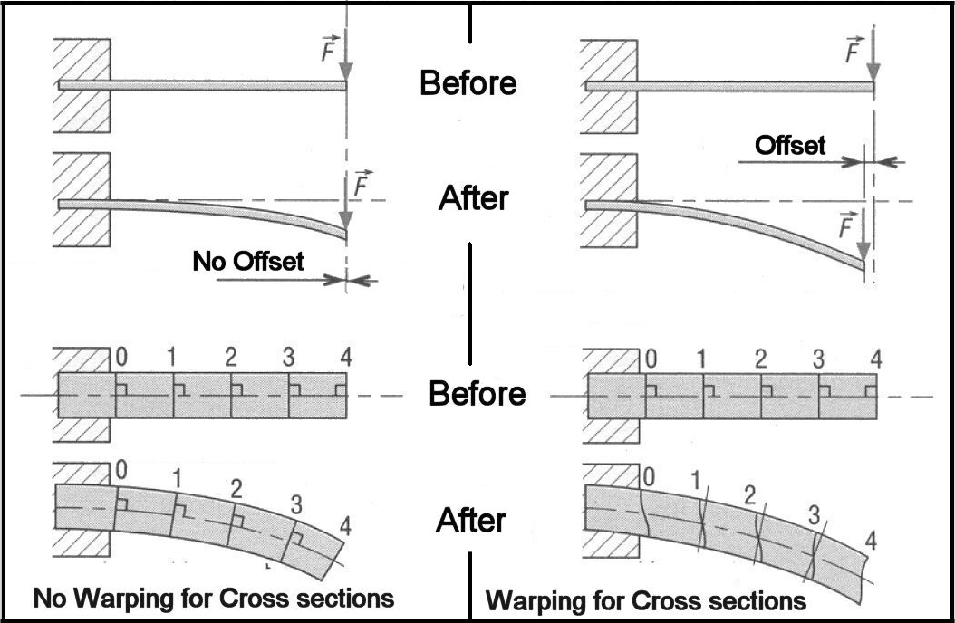
Reality / Hypothesis
Shear Force - Tian Jin - 2011

Slide 34
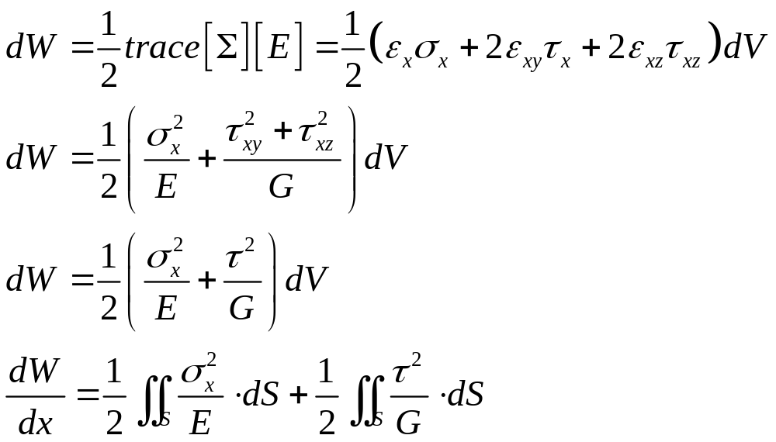
Internal Energy
Shear Force - Tian Jin - 2011

Slide 35
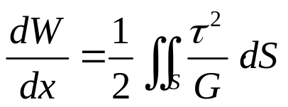
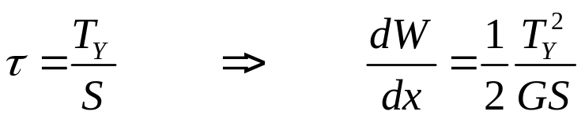
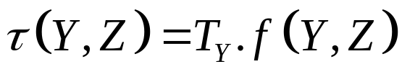
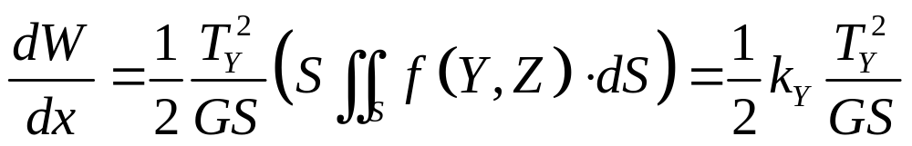
Internal Energy
Hyp :
As the shear stresses are not constant, but linear with respect of Ty :
Shear Force - Tian Jin - 2011

Slide 36
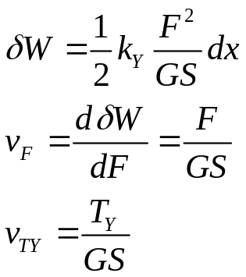
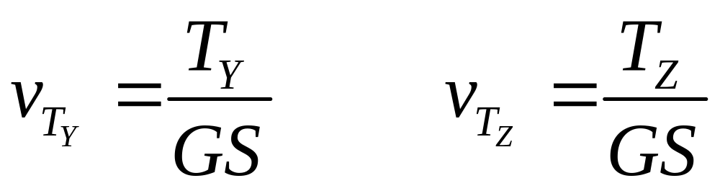
Displacement
Shear Force - Tian Jin - 2011

Slide 37
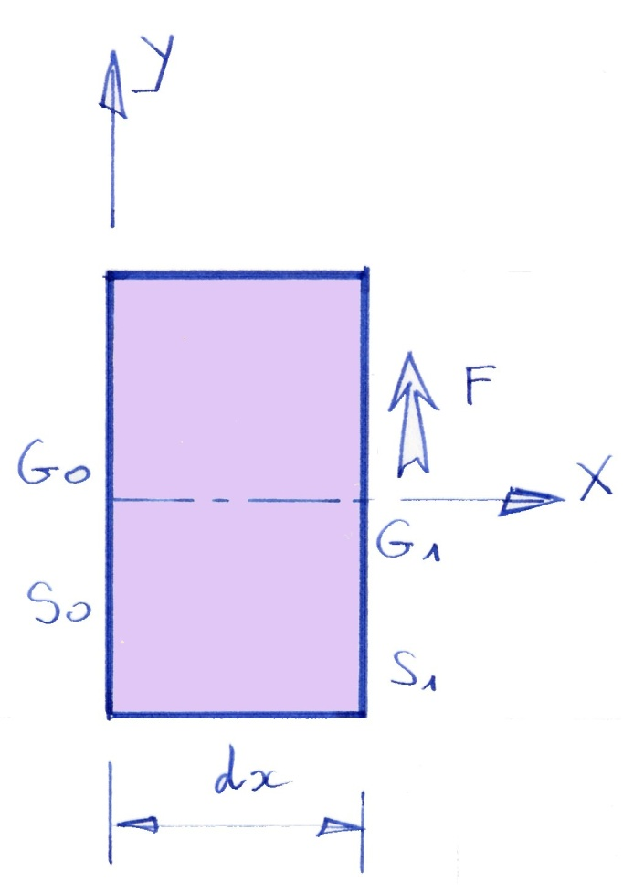


Displacement
Shear Force - Tian Jin - 2011

Slide 38


Displacement
Shear Force - Tian Jin - 2011

Slide 39


Circulation and Flow of the shear stress
Shear Force - Tian Jin - 2011

Slide 40



Circulation of the shear stress
We need
We need the Riemann’s Theorem
Shear Force - Tian Jin - 2011

Slide 41


Circulation of the shear stress
Shear Force - Tian Jin - 2011

Slide 42


Flow of the shear stress
We need
Shear Force - Tian Jin - 2011

Slide 43

Flow of the shear stress
Shear Force - Tian Jin - 2011

Slide 44

Flow of the shear stress
Shear Force - Tian Jin - 2011

Slide 45


Flow of the shear stress
Shear Force - Tian Jin - 2011

Slide 46
Flow of the shear stress
We write an equilibrium in the direction X
This result is known as the Bredt’s formula.
Take care : this formula is only usable in the principal axis system
Shear Force - Tian Jin - 2011

Slide 47

Exemple by using an approximation
Hypothesis : The shear stress does not depend of Z
Hyp 1 : The shear stress is constant
Hyp 2 : The shear stress is linear
Hyp 3 : The shear stress is quadratic
Shear Force - Tian Jin - 2011

Slide 48


Exemple by using the flow of the shear stress
Shear Force - Tian Jin - 2011

Slide 49

Thin wall structures
Shear Force - Tian Jin - 2011

Slide 50

Thin wall Structure
Shear Force - Tian Jin - 2011

Slide 51
Thin wall structures
There are different thin wall structures :
Closed cross section with one cavity,
Closed cross section with several cavities
Opened cross section
Shear Force - Tian Jin - 2011

Slide 52




Differents Cross Section
Shear Force - Tian Jin - 2011

Slide 53


Equations
Shear Force - Tian Jin - 2011

Slide 54
Thin wall structures : exemple
What are the objectives :
Define the cross section
  The position of the center of gravity
  The principal axis
  The quadratic moments
Find the stresses for each point,
Find the reduced section coefficient
Find the position of the shear center
Shear Force - Tian Jin - 2011

Slide 55


Thin wall structures : Exemple 1
Geometry
Shear Force - Tian Jin - 2011

Slide 56


Exemple 1 :
Center of Gravity
Shear Force - Tian Jin - 2011

Slide 57

Exemple 1 :
Principal axis
Shear Force - Tian Jin - 2011

Slide 58



Exemple 1: Stresses
Shear Force - Tian Jin - 2011

Slide 59

Exemple 1: ky
Shear Force - Tian Jin - 2011

Slide 60


Exemple 1: Shear center
Shear Force - Tian Jin - 2011

Slide 61


Thin wall structures : Exemple 2
Geometry
Shear Force - Tian Jin - 2011

Slide 62


Thin wall structures : Exemple 3
Shear Force - Tian Jin - 2011

Slide 63


Thin wall structures : Exemple 4
Shear Force - Tian Jin - 2011

Slide 64


Thin wall structures : Exemple 4
Shear Force - Tian Jin - 2011

